Slide 1
Correlation Analyses and Recoding Variables
MKTG 2341 Week 12 PC Lab
MKTG2341-09 PC Lab 12

Slide 2
Today’s Lab
Brief presentation on running correlation analyses in XLDA.
Also included in the presentation is a discussion of the reasons for recoding variables and the steps for recoding in XLDA. Posted for your reference only.
Review of the Data Analysis Quiz using College Life E-Zine data.
MKTG2341-09 PC Lab 12

Slide 3
Presentation Learning Outcomes
Understand how to run correlation analyses in XLDA.
Understand the reasons for recoding variables.
Understand how to recode variables in XLDA.
MKTG2341-09 PC Lab 12

Slide 4
Correlation Analyses
MKTG2341-09 PC Lab 12

Slide 5
Correlation Analysis: Review
correlations measure the linear relationship between two metric variables
we use the Pearson Product Moment Correlation analysis to calculate the correlation coefficient.
MKTG2341-09 PC Lab 12

Slide 6
Correlation Analysis: Review
  strength of the relationship is communicated by the absolute size of the correlation coefficient – “r”.
  An index from -1.0 to +1.0
  The closer the correlation coefficient is to ±1.0, the stronger the correlation or association.
MKTG2341-09 PC Lab 12

Slide 7
Correlation Analysis: Review
  The direction (+ or -) of the correlation coefficient determines the direction of the relationship.
MKTG2341-09 PC Lab 12

Slide 8
Running Correlations in XLDA
MKTG2341-09 PC Lab 12

Slide 9
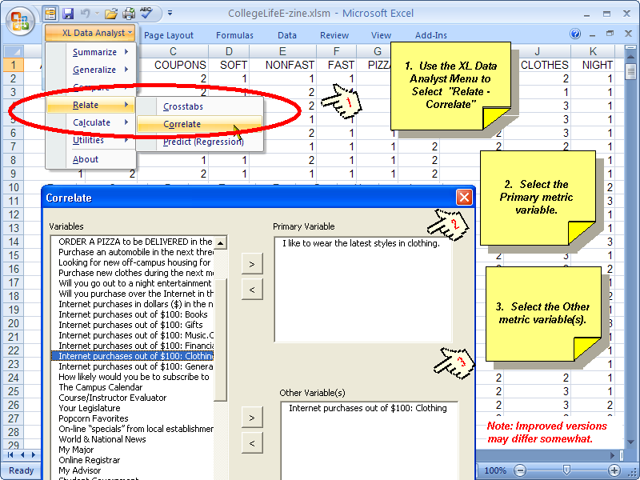
XLDA: Correlation Analysis
MKTG2341-09 PC Lab 12

Slide 10
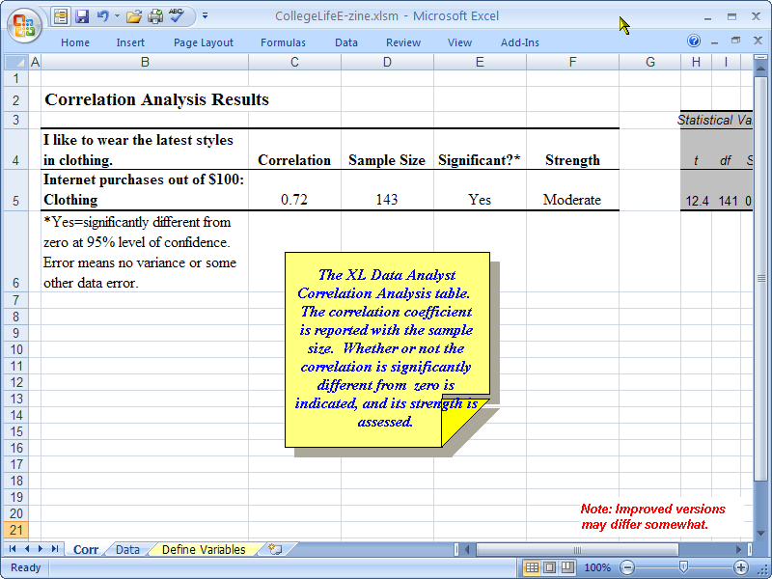
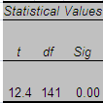
XLDA: Correlation Analysis
MKTG2341-09 PC Lab 12

Slide 11

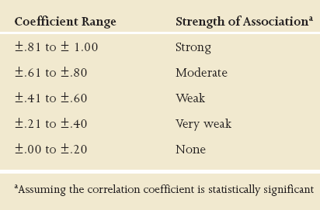
Strength of Association
Rules of Thumb:
The closer ‘r’ is to 1.0 the stronger the relationship.
MKTG2341-09 PC Lab 12

Slide 12
Recoding Variables
MKTG2341-09 PC Lab 12

Slide 13
Recoding Variables
We recode variables for two main reasons:
Because the number of respondents in some or all of our response categories are too small for reliable or meaningful analysis.
Because we want to analyze our data in a different way than it was originally collected.
MKTG2341-09 PC Lab 12

Slide 14
Recoding Variables
There is no ‘recode’ function in XLDA, but we do have a number of other options to choose from, including:
Writing a function to create new codes
Manually inserting new codes
MKTG2341-09 PC Lab 12

Slide 15
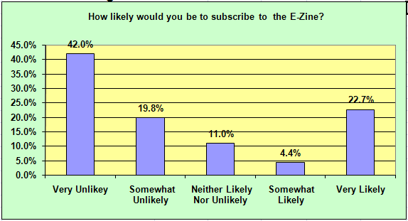
Example of Recoding
Here are the results to one of the questions in the College Life E-Zine survey…

Slide 16
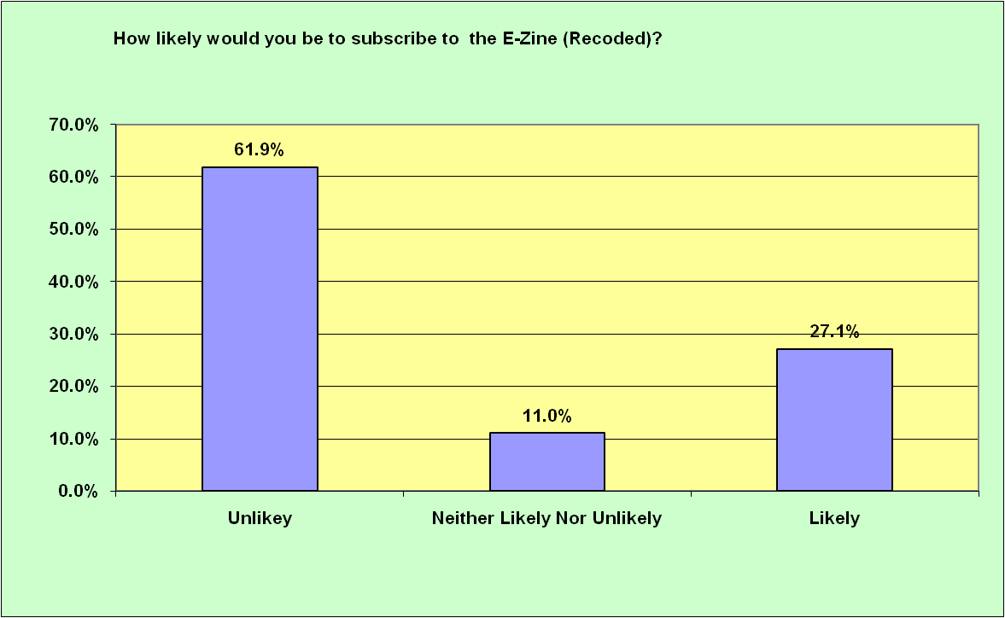
Example of Recoding
Let’s assume that we want to combine codes 1 and 2 (very and somewhat unlikely) as well as codes 3 and 4 (very and somewhat likely).

Slide 17
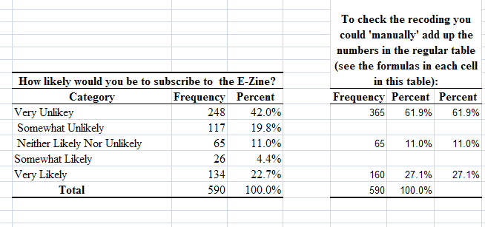
Example of Recoding
To check that your recoding works properly, you can manually add up the numbers in the regular table like this.

Slide 18
Example of Recoding
The first step in recoding is to prepare the database by Inserting a New Variable…

Slide 19
Inserting a New Variable in XLDA
1. In the DATA sheet, place the cursor in the Column heading where you want to insert a new variable.
2. Right click and choose Insert.
3. Type in the new Variable name. Ex: LIKELYNew
4. Copy the cell with the new variable name.
MKTG2341-09 PC Lab 12

Slide 20
Inserting a New Variable in XLDA
5. In the DEFINE VARIABLES sheet you need to make room for the new variable. You cannot use the insert function, so you need to Cut-and-Paste the variables to the right of where you want to insert the new variable.
MKTG2341-09 PC Lab 12

Slide 21
Inserting a New Variable in XLDA
6. In the DATA sheet: Copy the cell with the new variable name.
7. In the DEFINE VARIABLES Sheet, Paste Special and click Paste Link. This will link the new variable in the DATA sheet with the DEFINE VARIABLES sheet.
8. Now you are ready to define the Variable Description, Value Codes and Value Labels.

Slide 22
Recoding Variables
Once the database has been modified correctly, you have the choice of either creating a formula to generate the new codes or of manually entering the codes yourself.
Let’s look at how to create a formula…

Slide 23
Creating Formulas for New Codes
In the DATA Sheet: in cell U2 type in the Recode Logic: =IF(T2<3,1,IF(T2=3,2,IF(T2>3,3))) This will recode the values less than 3 (i.e.1 and 2) as new value 1, values 3 as new value 2, and Values over 3 (i.e. 4 and 5) as new value 3.

Slide 24
Creating Formulas for New Codes
Copy and paste cell U2 to the entire column U. Visually check if the recoding is correct. The problem is that the new codes are not numeric. You can change this by Copy-Paste Special (Values):
Copy the cells U2 to the end of data in Column U.

Slide 25
Creating Formulas for New Codes
Paste Special click Values. The data in the cells in Column U are now numbers. You will also note that the IF statement logic is gone.
In the DEFINE VARIABLES Sheet enter the appropriate Variable Description, Value Code, and Value Labels.

Slide 26
Manually Creating New Codes
It is also possible to manually create new codes. Start by creating a coding sheet such as: Old Code New Code 1-2=1, 3=2, and 4-5=3

Slide 27
Manually Creating New Codes
In the DATA Sheet: manually go down the column of the Old variable, each time you encounter a value, check the coding sheet and enter the new value in the Recoded variable column.
In the DEFINE VARIABLES Sheet enter the appropriate Variable Description, Value Code, and Value Labels.

Slide 28
Review of the Data Analysis Quiz
MKTG2341-09 PC Lab 12

